Slide 1







Comenius group Italy
PRESENTS

Slide 2
Educational Italian Sistem

Slide 3

In Italy, the educational system is composed by:
Infant school 3 years
Primary school 5 years
Junior secondary school 3 years
High secondary school 5 years
University 5 years

Slide 4
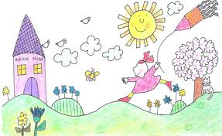

Infant school
Children attend the infant school from three to five year
Two teachers in each section
 | structure
First section | 3/4
Second s. | 4/5
Third s. | 5/6
forty weekly hours
free on saturday

Slide 5
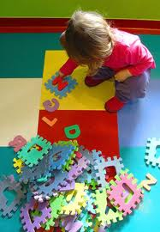
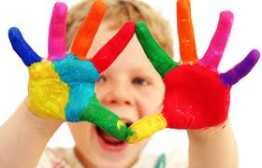
This school
is very important
because children learning
by doing...

Slide 6
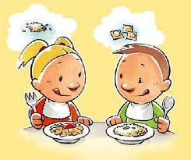
School canteen ….

Slide 7

Primary school
Primary school is one of the foundamental social context for
developing the personality of each child
 | structure
First class | 6/7
Second c. | 7/8
Third c. | 8/9
Fourth c. s | 9/10
Fifth c. | 10/11
Children attend the primary school from six to ten year

Slide 8


Primary school marks the start
of compulsory education
Children having reached the
age of six start to attend
primary school This school
is divided in a monoennio and two year periods
No fee is payable for attending
primary school and the text books are free.
The number of pupils in each class
as a rule does execeed 25 and is
not lower than 10

Slide 9

EDUCATIONAL PROGRAMMES
Teaching models adopted
Teaching | models
First model | 27 hours
Second m . | 30 h.
Third m . | 40 h.

Slide 10
There is a close
collaboration between …
Skate
holders
territory
school
…Each school
can elaborate its own programme ,
project of work and Its own activities…

Slide 11
Compulsory subjects in the
Primary School
Geography
History
Maths
Italian
a foreign language
Religion
Sound and music education
Science
Visual image
education
Sound and
music education
Computer science

Slide 12

Junior secondary school
it’s the second level of compulsory teaching.
 | structure
First class | 11/12
Second c. | 12/13
Third c. | 13/14

Slide 13


No fee is payable for attending junior secondary school but text books are not free
The number of pupils in each class as a rule does execeed 28
and is not lower than 12 If a class includes
one o more pupils with disabilities, the total number
of pupils will not exceed 20

Slide 14

EDUCATIONAL
PROGRAMMES
Teaching models adopted
Teaching | models
First model | 30 hours
Second model | 36 h.
one or two weekly returns

Slide 15
There is a close collaboration
between …
Each school is free to organize its activities
taking due accont of the needs
of the skateholders
( family , pupils and local territory)
and ,in doing it, it must respect the general objectives
of the national educational system
Skate
holders
territory
school

Slide 16
compulsory subjects in the
junior secondary school
geography
italian
history
maths
technology
Two foreign languages
sound and music education
religion
science
citizenship.
visual image education
sound and music education
computer science

Slide 17

Santa Caterina Villarmosa
Resuttano
Our schools:
Istituto Comprensivo
Our school is composed by two municipal districts:
Santa Caterina Villarmosa and Resuttano
In each town there are :
Infant school
Primary school
Junior secondary school

Slide 18

Resuttano:
Infant school
2
section
44 pupils
4 teachers
Primary school
5 classrooms
75
pupils
11
teachers
Junior secondary school
3
classrooms
69
pupils
18
teachers

Slide 19
Our teaching model adopted:
Resuttano
Infant school
Its timetable is forty weekly hours ( morning and afternoon) lessons start at 8.00 and finish at 16.00 p.m.
they are free on Saturday In the infant school
there is a school canteen where children and teachers can eat

Slide 20
Our teaching model adopted:
Resuttano primary school
Its timetable is forty weekly hours .
lessons start at 8.15 and finish at 16.15 p.m.
they are free on Saturday
there is a school canteen where children and teachers can eat

Slide 21
Junior secondary school
Its timetable is 36 weekly hours lessons start at 8.00 and finish at 16.00 p.m.
they are free on Saturday

Slide 22
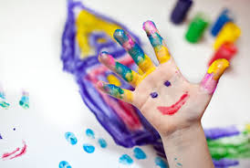
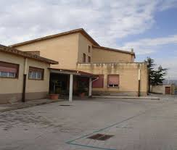
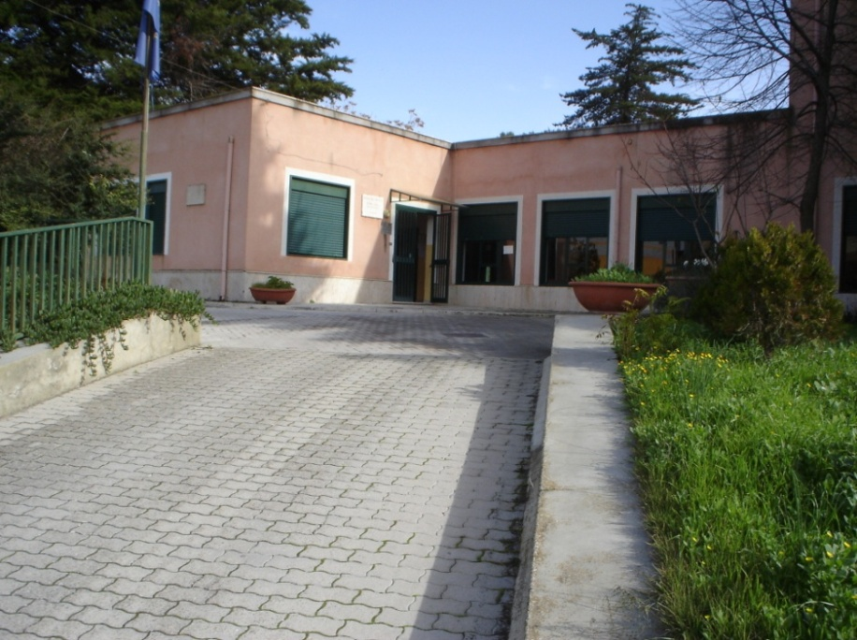
Santa Caterina Villarmosa
Infant schools
“S. Anna”
68
pupils
M. T.
Calcutta
67
pupils
3
sections
6
teachers
3
sections
7
teachers

Slide 23
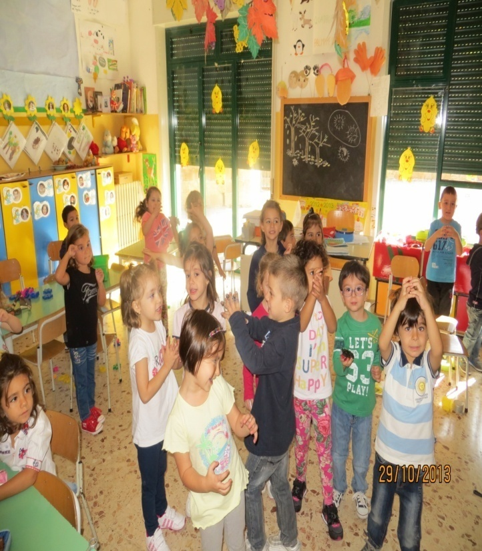
Timetable Infant schools
Their timetable is forty weekly hours
( morning and afternoon) lessons
start at 8.00 and finish at 16.00 p.m.
they are free on Saturday. In the
infant schools there are two schools
canteen where children and teachers can eat

Slide 24
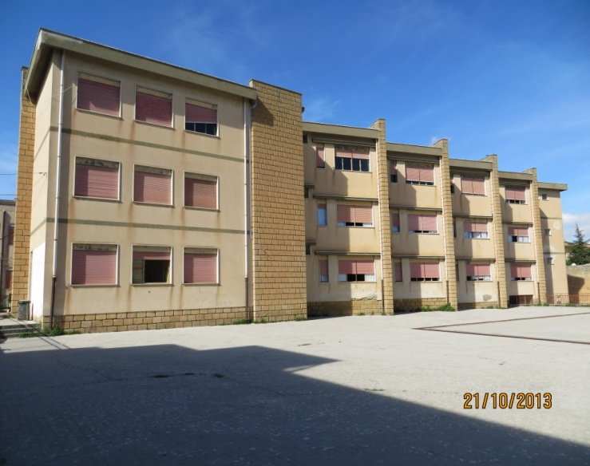
G. ZANELLA
Primary
school
236
pupils
20
teachers
13
classrooms

Slide 25

Our teaching model adopted:
primary school
In our primary school there are two models of teaching.
The first is the prevaling teacher ,and the second is the teaching module. The prevaling teacher works only in one classroom
In the teaching module , however, there is a group of teachers (3 teachers for two classes or four teachers for three classes).
Its timetable is 27 weekly hours .Lessons start at 8.00 and finish at 13.30.
they are free on Saturday

Slide 26
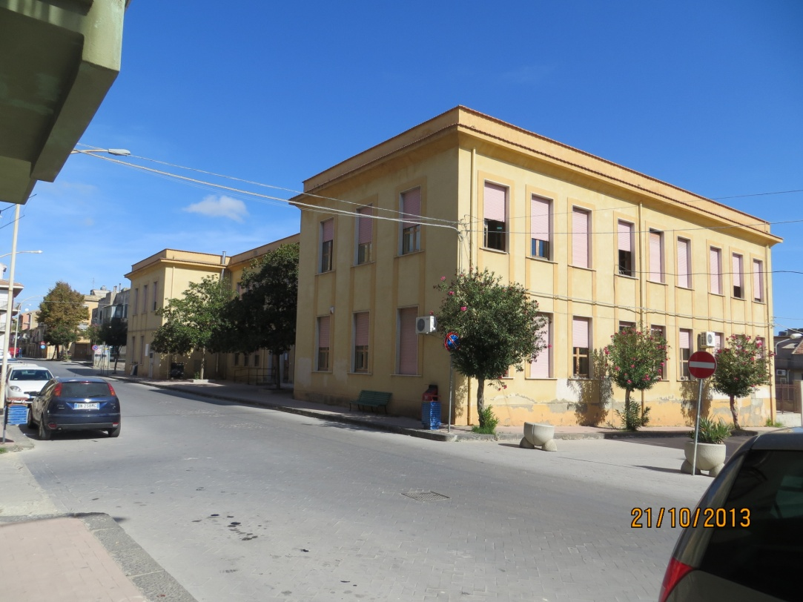
Junior secondary school
Don Bosco
8
classrooms
20
teachers
178
pupils
Notes:
26

Slide 27

Don Bosco
There are two types of teaching:
the normal time and the extended time.
In normal time school starts at 8:00 and ends at 13.30 (30 hours per week).
In the extended time school starts at 8.30 and ends at 13.30 and there are two weekly returns (36 hours per week)

Slide 28

P.O.F.
(Piano dell'offerta formativa)
All the choices every school decides through its components (teachers headmaster, parents delegation) set the FORMATIVE OFFER PLAN that is the official document approved by the school council
The POF is a public document in which you express school autonomy, curricular flexibility and organizational responsibility for the school in making decisions. It is approved by the Council of the Institute, developed by the College of Teachers,

Slide 29

P.O.F.
Cultural and educational choices
Expansion of the Educational
Choices
teaching and organization
Educational Goals
Goals for the development of skills
Structuring the Curriculum
Methodological strategies
Projects
Orientation
Outputs educational

Slide 30

THE HEAD MASTER
The headmaster is responsible for overall management of the institution,
of wich he has legal responsability
He is responsible for the management of financial and material
resources and for the quality of the service
provided.
With due respect of competencies of school councils,
the headmaster has autonomy
in his role of directions,coordination,and exploitation of resources.
He provides for the collaboration between school and every cultural
professional and economic resources present
in the community
In his work ,the headmaster can resort to teachers,whom he will have selected,
and in addition he is assisted by
the administrative director and the school office staff

Slide 31
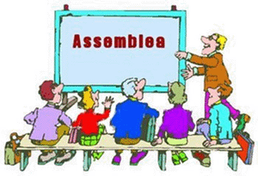
TEACHERS' ASSEMBLY
The teachers' assembly is made up of the permanent and temporary teachers of the school.
The Assembly periodically evaluates the general development of didattics to ensure.
Its worth in keeping with the planned objectives, and proposes appropriate measures to improve educational activities
(wherever necessary).
The teachers' assembly selects textbooks, having consulted the INTER CLASS COUNCIL and teaching materials within the financial limits laid down by the SCHOOL COUNCIL.
It is consulted by headmaster as regards class formation, lesson timetables and the performances of school activities, taking account of the general criteria laid down by the CLASS COUNCIL

Slide 32
METHODOLOGICAL STRATEGIES
in our school, in order to attain the educational goals, teachers promote significant learning that ensure educational success for each student.
Teachers, while respecting the freedom of teaching, recognize some methodologies as privileged in order to achieve the educational objectives and cognitive set, and for the acquisition of skills. Each teacher can promote, within the class, varius activities that offer to the pupil the opportunity to experiment, produce, process in a creative way to reflect on the learning and knowledge learned.
methodology
Value experience
Encourage exploration and discovery through individualized
To stimulate collaborative learning
Promoting autonomy in the study
Encourage self-esteemre

